Slide 1
Empowering and enabling the logistics industry globally.
Behavioral Design Patterns
Nancy Li
Software Developer
11 Aug 2023

Slide 2
Design Patterns
Behavioral Design Patterns
Creational Design Patterns
Structural Design Patterns
Notes:
Design patterns are typical solutions to commonly occurring problems in software design.
When a solution gets repeated over and over in various projects, someone eventually puts a name to it and describes the solution in detail.
That’s basically how a pattern gets discovered.
You can follow the pattern details and implement a solution that suits the realities of your own program.
Design patterns are divided into three main categories
The first category is Creational patterns, for which I made a presentation last year.
The second is Structural patterns. That's what I want to talk about today.
Structural patterns explain how to assemble objects and classes into larger structures, while keeping these structures flexible and efficient.
//Creational patterns provide object creation mechanisms that increase flexibility and reuse of existing code.
//Behavioral patterns take care of effective communication and the assignment of responsibilities between objects.

Slide 3
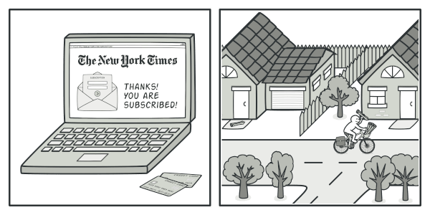
1. Observer
Notes:
观察者模式是一种行为模式，用于在对象之间建立一种一对多的依赖关系。
当一个对象的状态发生变化时，它会自动通知其依赖对象，使得依赖对象能够自动更新自己

Slide 4
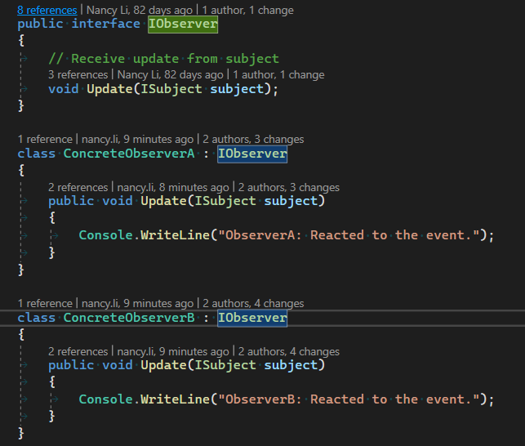
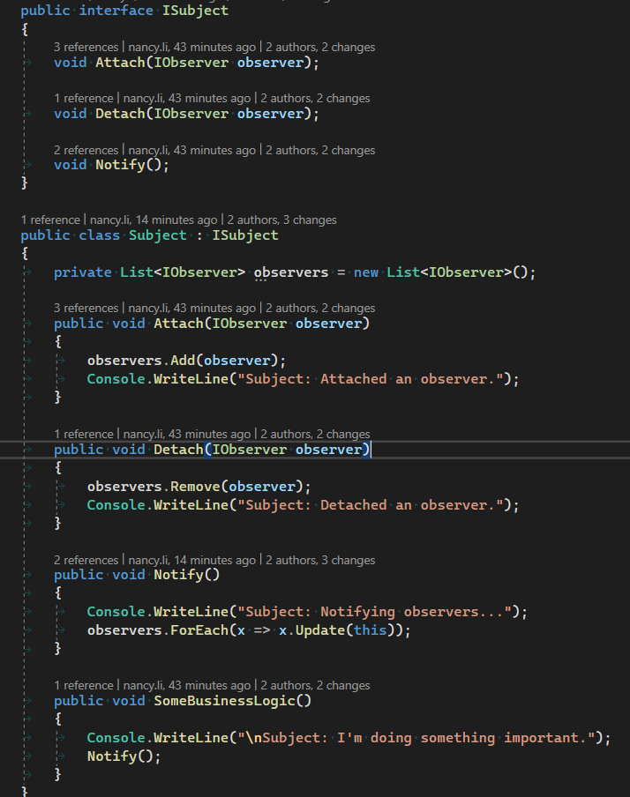
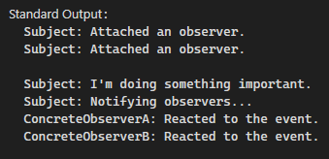
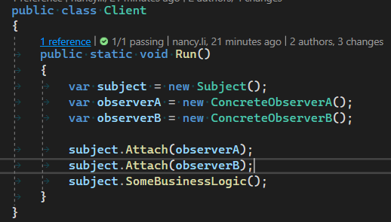
1. Observer

Slide 5
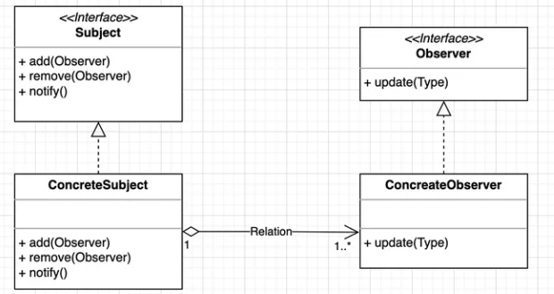
1. Observer
Subject
Observer
Notes:
在这种模式中，存在两种类型的对象：主题（Subject）和观察者（Observer）
主题（Subject）是被观察的对象，它维护着一个观察者列表，并提供了用于添加、删除和通知观察者的方法。
当主题的状态发生变化时，它会遍历观察者列表，调用每个观察者的更新方法，以通知它们状态的改变。
观察者（Observer）是依赖于主题的对象，它们通过注册到主题上来接收状态的变化通知。
观察者必须实现一个更新方法，以便主题在状态改变时能够调用它们的更新方法。

Slide 6
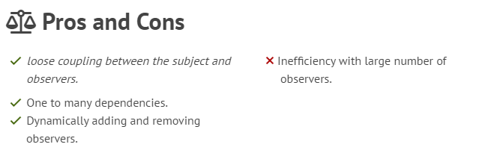
1. Observer
Notes:
观察者模式具有以下优点：
1. 松耦合 Loose coupling between the subject and observers.
观察者模式将主题和观察者解耦，它们之间通过抽象的接口进行通信，主题不需要知道观察者的具体实现。这种松耦合的设计使得主题和观察者可以独立地进行扩展和修改。
2. 一对多的依赖关系 One to many dependencies.
观察者模式支持一对多的依赖关系，一个主题可以有多个观察者。这意味着当主题的状态发生变化时，所有观察者都能够接收到通知并进行相应的处理。
3. 动态添加和删除观察者 Dynamically adding and removing observers.
观察者模式允许在运行时动态地添加和删除观察者，主题和观察者之间的关系是动态的。这种灵活性使得系统的设计更加可扩展和可维护。
观察者模式也存在一些缺点：
1. 观察者过多导致性能问题：当观察者过多时，主题在通知所有观察者时可能会导致性能问题，特别是当观察者的处理逻辑较为复杂或者通知频繁时。
2. 循环依赖问题：在观察者模式中，观察者和主题之间存在双向依赖关系。如果设计不当，可能会导致循环依赖的问题，使系统变得复杂并增加了维护的难度。

Slide 7
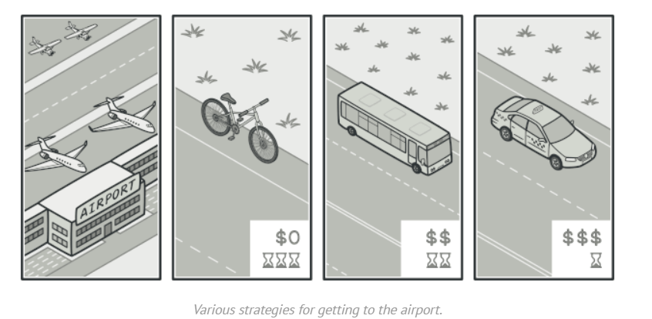
2. Strategy

Slide 8
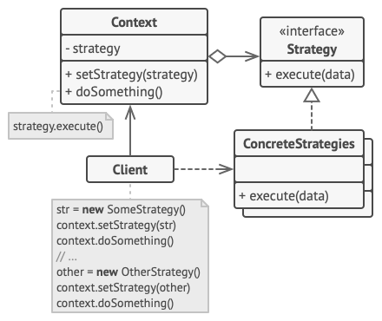
2. Strategy
Context
Strategy
Concrete Strategy

Slide 9
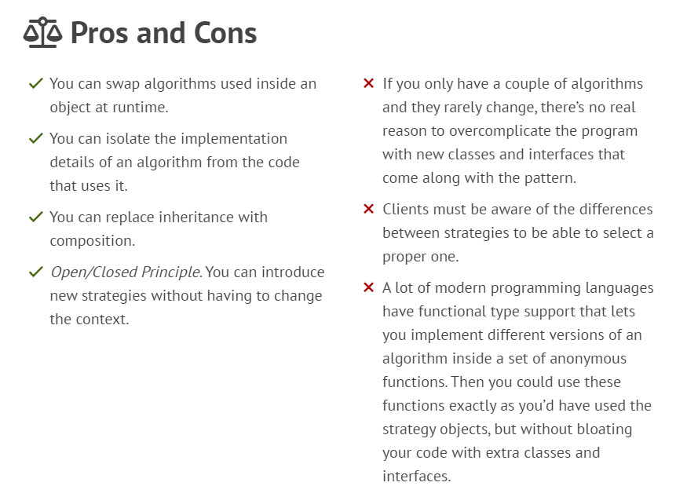
2. Strategy

Slide 10
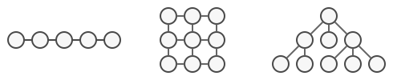
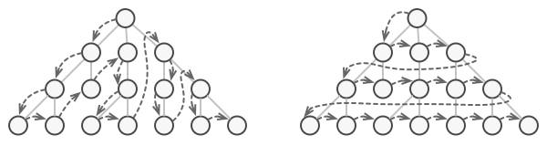
3. Iterator
The same collection can be traversed in several different ways.

Slide 11
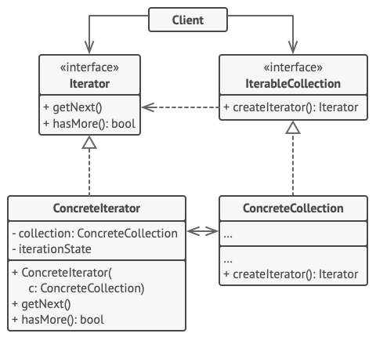
3. Iterator
Iterator
Concrete Iterators

Slide 12
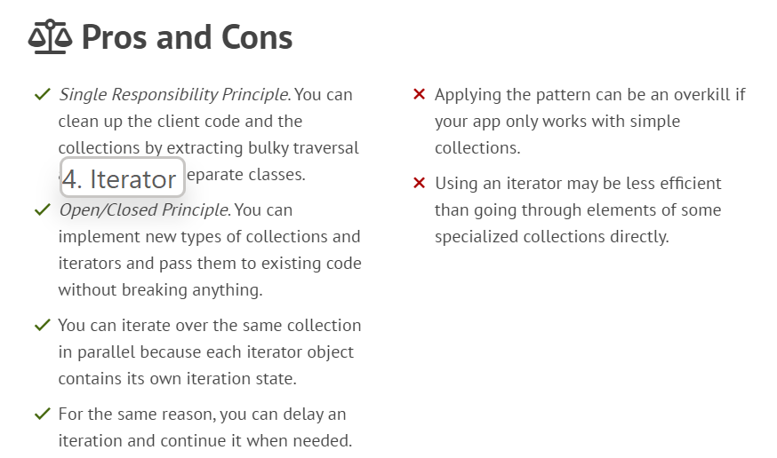
3. Iterator

Slide 13
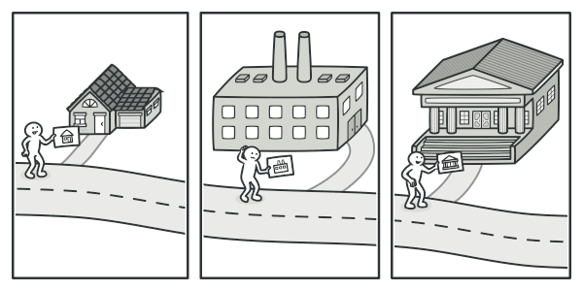
5. Visitor

Slide 14
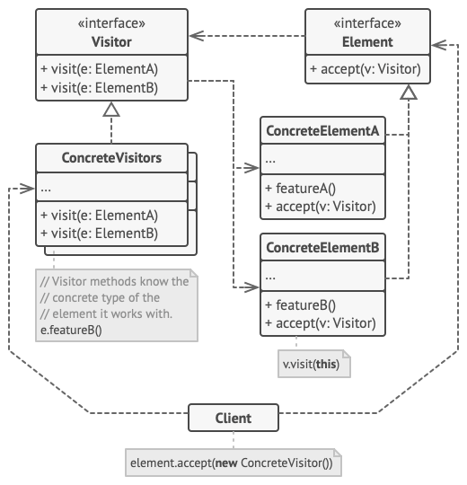
5. Visitor
Element
Concrete Visitors
Visitor
Concrete Elements

Slide 15
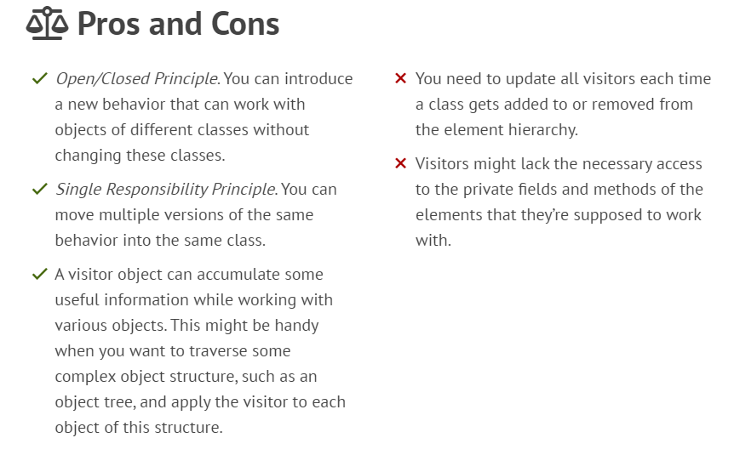
5. Visitor

Slide 16
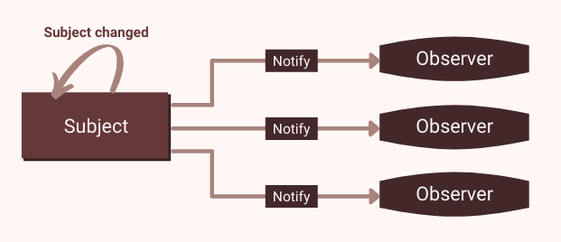
Behavioral Design Patterns
1. Observer
2. Strategy
3. Iterator
…….
5. Visitor
4. Command
Notes:
These are the five Structural Design Patterns.
I hope it can be helpful to everyone.

Slide 17
Q&A

Slide 18
Empowering and enabling the logistics industry globally.
Thank You!

